Slide 1
MINI-PROJECT PHASE-01
PRESENTATION ON
Fire Alarm Using Thermistor
By:
Lokesh Y 1NH18EC061
Madala Bhanu Prakash 1NH18EC064
M Suchith 1NH18EC063
Santhosh Gowda M 1NH18EC102
Guided By:
Ms.Divya Rajan
Senior Assistant Professor
Dept. of ECE
New Horizon College Of Engineering
24/10/2019

Slide 2
INDEX
Introduction
Circuit diagram
Literature Survey
Aim and Objectives of Project
Top Level Block Diagram
Project Description
Milestones/Schedule
Progress Work
Outcome of Project
References
24/10/2019

Slide 3
INTRODUCTION
A fire alarm system has a number of devices working together to detect and warn people through visual and audio appliances when smoke, fire, carbon monoxide or other emergencies are present.
Fire Alarm Systems essentially operate as, If a detector detects smoke or heat or someone operates a break glass unit (manual break point), then alarm sounders operate to warn others in the building that there may be a fire and to evacuate.
Some advantages of fire alarms include an early warning benefit and the potential to save life and property, low cost and the opportunity to place the device in chosen locations. It is a key recommendation in any fire prevention plan.
24/10/2019

Slide 4
Here, A simple fire alarm system is built with the help of 555 Timer IC, which will sense the fire (temperature rise in surrounding), and trigger the alarm.
The key component of the circuit is Thermistor(which has been used as fire detector or fire sensor) and BC548 npn transistor.
24/10/2019

Slide 5
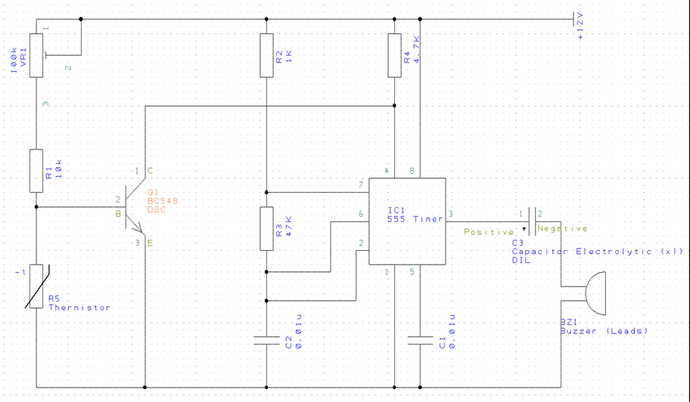
CIRCUIT DIAGRAM

Slide 6
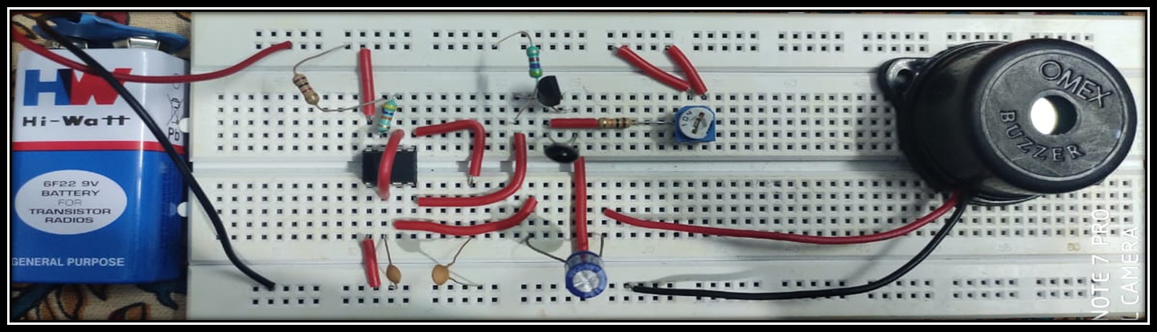
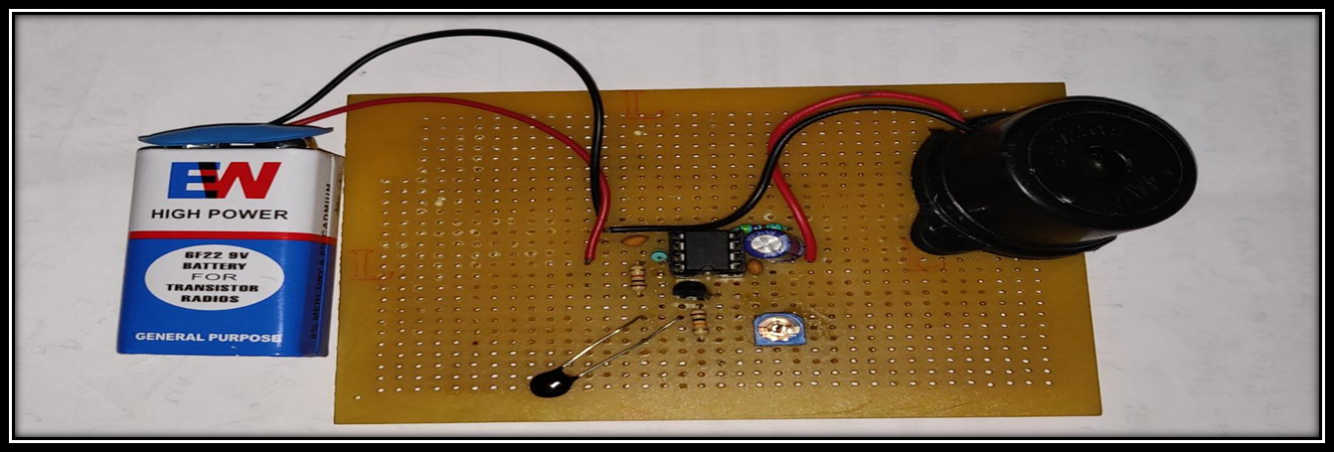
24/10/2019

Slide 7
Literature Review
PAPER NO | TITLE | AUTHOR AND YEAR OF PUBLICATION | OUTCOME
1. | Research on electronic fire alarm | Manav Jain and Dr.Mohammad Jawaid 2014 | Information on the various circuits for detecting fire and circuit for the fire alarm using ic555 was obtained.
2. | Smart automation on basis of IC555 | Krishna Sarath Chandra, Vamsi Bharadwaj Reddy 2016 | Information on basis, components, advantages and applications of IC555 were obtained which helped us understand the working of IC.
3. | Transistors | Michael Riordian,Lillian Hoddeson , Conyers Herring 1999 | Information on Importance, applications and working of the transistor in the circuit were obtained to analyze the circuit better.
4. | Study of MC based fire alarm using temperature sensor | Alishetty Ramu,Bathula,Kiran Kumar,Mamilla Bhavani 2017 | Details on the requirement and function of thermistor used in the circuit were imbibed.
24/10/2019

Slide 8
AIM and OBJECTIVE
AIM:
To sense smoke, excessive heat or fire and provide an alert for that particular region where its placed to take specified action.
Objective:
To detect fire in the disaster prone area.
Also provide audio and video indications.
Extinguishes fire on detection
Reduces the efforts of human labour and level of destruction
24/10/2019

Slide 9
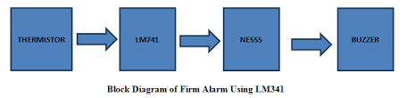
TOP LEVEL BLOCK DIAGRAM
Fire alarm circuit is built using, mainly three components that is, Thermistor, BC548 npn transistor and 555 Timer IC
Transistor BC548
BASIC BLOCK DIAGRAM OF FIRE ALARM
24/10/2019

Slide 10
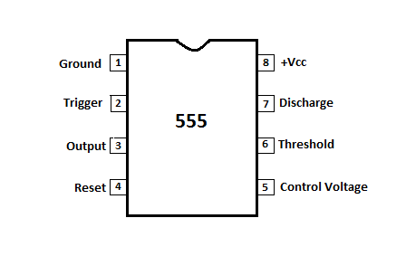
PROJECT DESCRIPTION
The fire alarm circuit is built using, mainly three components that is, Thermistor, BC548 npn transistor and 555 Timer IC
555 TIMER IC:
555 timer is used in almost every electronic circuit today. For a 555 timer working as a flipflop or as a multi-vibrator, it has a particular set of configurations. Some of the major features of the 555 timer would be,
It operates from a wide range of power ranging from +5 Volts to +18 Volts supply voltage.
24/10/2019

Slide 11

The output of a 555 timer can drive a transistor-transistor logic (TTL) due to its high current output.
THERMISTOR
A thermistor (or thermal resistor) is defined
as a type of resistor whose electrical resistance varies
with changes in temperature. Although all resistors’
resistance will fluctuate slightly with temperature, a
thermistor is particularly sensitive to
temperature changes
24/10/2019

Slide 12
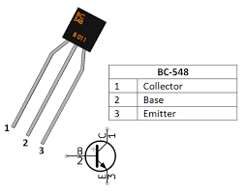
BC548 npn Transistor:
BC548 is a npn transistor so the collector and
emitter will be left open (Reverse biased) when the
base pin is held at ground and will be closed (Forward biased)
when a signal is provided to base pin.
BC548 has a gain value of 110 to 800, this value determines the amplification capacity of the transistor.
The maximum amount of current that could flow through the Collector pin is 500mA, hence we cannot connect loads that consume more than 500mA using this transistor
24/10/2019

Slide 13
Working
Here is a simple fire alarm circuit built around 555 timer IC.A thermistor(10K ohm) used here as heat sensor At room temperature the reverse resistance of the thermistor being very high ( over 10-kilohm),it produces no effect on transistor TI which conducts and keeps the reset pin (4) of Il at ground level,and so the alarm does not sound
When temperature of thermistor (the sensor) increases in the case of a fire, the reverse resistance of thermistor (the sensor) drops. At about 70 C its resistance drops to a value below 1-kilohm. This stops TI's conduction and the ic's reset pin 4 becomes positive through resistor R2, which sounds the alarm.
For installation of the alarm, two or three reverse biased germanium diodes connected in parallel can be kept at different locations. In case of a fire, any of the diodes can sense the heat and raise the alarm
24/10/2019

Slide 14
PROGRESS WORK
Phase 1: Mini Project topics were suited for consideration
Phase 2: Mini project topic was finalized as Fire alarm.
- The components for making the working model were
purchased.
Phase 3: Working model preparation commenced.
-Working on presentation commenced.
Phase 4: Report making commenced.
- 90% working model completed on PCB
Phase 5: Presentation completed.
-50% Report completed.
Phase 6: Report completed
-Working model completed
24/10/2019

Slide 15
Milestones/Schedule
Table A - Milestones scheduled for achievement and performance against those milestones:
Milestone | Baseline Date | Target Date | Achievement
Components | 01/09/2019 | 02/09/2019 | Completed
Circuit connections | 03/09/2019 | 26/10/2019 | Completed
Powerpoint | 13/09/2019 | 24/10/2019 | Completed
Report | 12/09/2019 | 26/10/2019 | Completed
24/10/2019

Slide 16
Project Work Distribution
Name of Team Member | Work distributed
Lokesh.Y | Powerpoint and its information
Bhanu Prakash Madala | To gain information
Suchith | Report and its information
Santhosh Gowda.M | Purchase of Components and gaining of information
All | Circuit analysis and circuit building
24/10/2019

Slide 17
OUTCOME OF PROJECT
Fire alarm circuit senses smoke, excessive heat or fire and provide an alert for that particular region where its placed to take specified action.
And its application are seen in:
Offices and commercial
Apartments
Shopping and retail
Educational instituitions
Hotels and leisure
Hospitals and health
and many more
24/10/2019

Slide 18
REFERENCES
Manav Jain and Dr.Mohammad Jawaid’s , “ Research on electronic fire alarm”, IEEE, 2014.
Krishna Sarath Chandra and Vamsi Bharadwaj Reddy’s , “Smart automation on basis of IC555”, IEEE,2016.
Micheal Riordian, Lillian Hoddeson, Conyers Herring’s , “ Transistor”,IEEE,1999.
Alishetty Ramu, Bathula, Kiran Kumar, Mamilla Bhavani’s , “Study of MC based fire alarm using temperature sensor”,IEEE,2017
D Roy Choudry Shail Bala Jain’s , “Linear Integrated Circuits”, NAI publications.
http://www.idc-online.com/technical_references/pdfs/electronic_engineering/Thermistors%20Types%20and%20Applications.pdf
https://components101.com/transistors/bc548-npn-transistor
24/10/2019

Slide 19


